Slide 1

Fake News Detection Using NLP Classifiers
YADHU KRISHNAN V B
ANGEL TREESA JOHN
ANAGHA S
Notes:
1

Slide 2


INTRODUCTION
Fake news spreads rapidly through social media
Misleads public opinion and decision-making
Difficult to detect manually
Need for automated fake news detection systems
Notes:
2

Slide 3

PROBLEM STATEMENT
Challenges in Fake News Detection
Primary Objective
Distinguishing fake vs real news is challenging
Goal: Build a robust classification system
Language can be intentionally misleading
Traditional methods lack accuracy
Notes:
3

Slide 4


1
Classify news as Fake or Real
Project Objectives
2
Use NLP techniques for feature extraction
The primary goals of this research involve building a robust classification system and comparing various NLP models to effectively detect fake news.
3
Compare multiple models: Logistic Regression, Gradient Boosting, BERT
4
Analyze linguistic patterns
5
Evaluate cross-domain performance
Notes:
4

Slide 5




DATASET & PREPROCESSING
Dataset (LIAR)
Data Preprocessing
Dataset used: LIAR Dataset
1
Lowercasing text
Contains: News statements with labels (Fake/Real)
Key features:
2
Removing punctuation
Text content
Metadata
3
Stopword removal
Speaker information
Credit history
4
Tokenization
Goal
Converts raw text → machine-readable format
Notes:
5

Slide 6

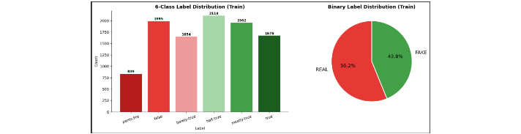

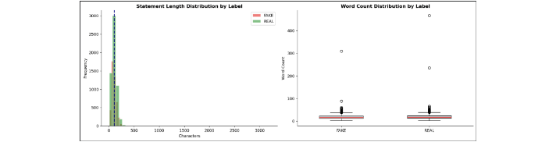
EDA
Label Distribution
6-Class Label Distribution (Train)
The dataset originally contains 6-class labels: pants-fire, false, barely-true, half-true, mostly-true, and true.
For the purpose of this study, the dataset is simplified for binary classification.
The binary split in the training set shows a relatively balanced distribution: 56.2% REAL vs 43.8% FAKE.
Binary Label Distribution (Train)
MSc Project Presentation
Notes:
6

Slide 7
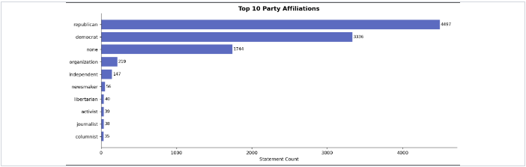
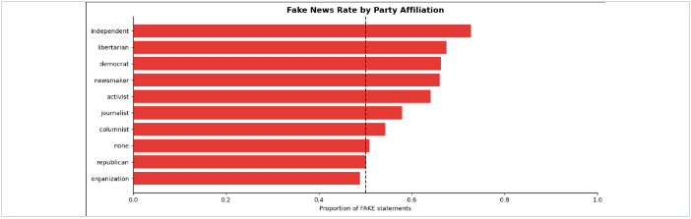
EDA
Text Characteristics
Observations
Statement Length Distribution by Label
●
Visual comparison of length/word-count distributions
●
Fake news often uses simpler language and emotional tone (hypothesis to test)
Word Count Distribution by Label
Notes:
7

Slide 8

FEATURE ENGINEERING
Text Vectorization
Linguistic features
TF-IDF (Term Frequency–Inverse Document Frequency)
Sentence length
Readability index
Punctuation usage
Custom ratios & counts
Metadata
deception_ratio
Credit history features (speaker-level)
truth_ratio
number_count
Notes:
8

Slide 9





MODELS
Models Used
Traditional ML
Traditional ML
Deep Learning
Logistic Regression
Gradient Boosting
DistilBERT
Traditional ML baseline model using linear classification.
Ensemble technique combining weak learners for complex patterns.
Deep Learning Transformer model for semantic understanding.
Enables comparison between simple & advanced models
Notes:
9

Slide 10
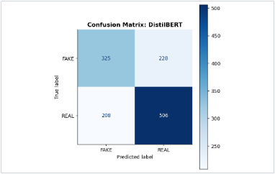
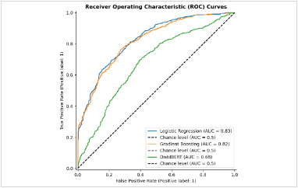
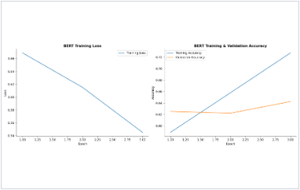

RESULTS
Model Performance Comparison
Performance Metrics
ROC Curves (AUC Comparison)
BERT Training Performance
Performance Highlights
Traditional ML outperformed the transformer model on this dataset
Logistic Regression: Accuracy ~73.6%, AUC = 0.83
Gradient Boosting: Accuracy ~74.3%, AUC = 0.82
Simpler models with strong linguistic features proved more robust for this specific domain.
DistilBERT: underperforming, AUC = 0.68
Notes:
10

Slide 11


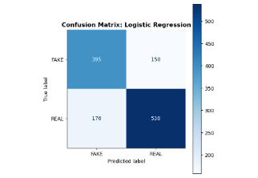
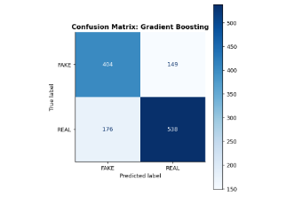
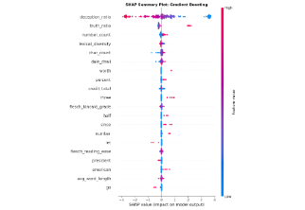

Confusion Matrix Analysis
Logistic Regression
Gradient Boosting
DistilBERT
TP: 538 | TN: 395
TP: 538 | TN: 404
TP: 506 | TN: 325
Error Pattern Insight
Traditional ML models maintain identical performance on Real statements (TP=538).
Both traditional models show notable False Negatives (Real predicted as Fake). Gradient Boosting achieved the highest True Negative count, effectively identifying 9 more fake statements than Logistic Regression.
DistilBERT struggles significantly with True Negatives compared to ML baselines.
Notes:
11

Slide 12

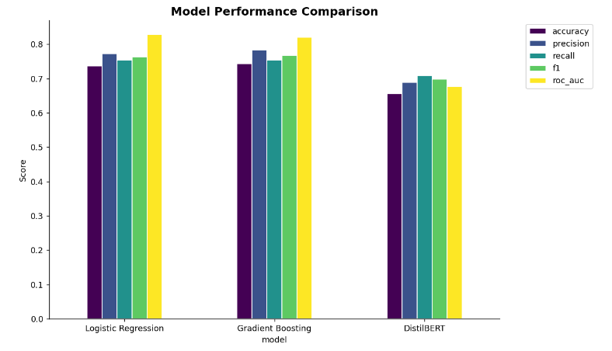


Model Explainability — SHAP
Key Insights
Top predictor: deception_ratio
Secondary predictors: truth_ratio, number_count
Decisions are driven by quantifiable linguistic features
Notes:
12

Slide 13

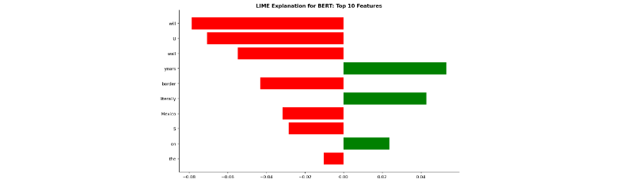




Model Explainability — LIME & Feature Importance
Linguistic Signals
Influential Words (LIME)
“will”, “wall”, “Mexico”, “border”
REAL Indicators (LR)
“since”, “still”, “debt”, “percent”
Suggests reliance on topic-specific political language
Notes:
13

Slide 14

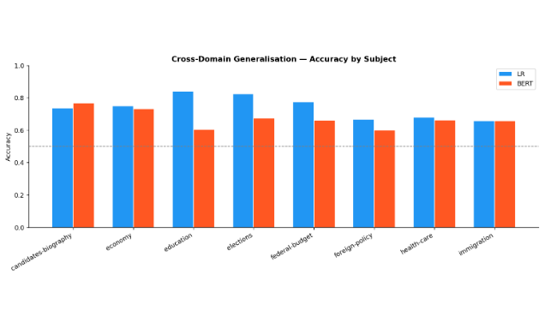


Cross-Domain Generalization
Key Observations
LR consistently outperforms BERT across domains
LR shows better generalization in specific subjects like foreign-policy and federal-budget
BERT exhibits higher variance and potential overfitting to training domain
Simpler models with strong features generalize better on this dataset
Accuracy Comparison across different news subjects
Notes:
14

Slide 15
Key Findings & Conclusion
Gradient Boosting achieved best performance (small margin)
Traditional ML outperformed DistilBERT for this dataset
deception_ratio is the most important feature (per SHAP)
Political/economic topics dominate the vocabulary signal
Linguistic features improve detection
Implication: Simpler models + strong features can beat complex models on domain-specific data. Traditional ML can be highly effective for domain-specific datasets.
System can be used in real-world applications (with monitoring for bias)
Notes:
15

Slide 16
Future Work
Use larger datasets & Real-time detection
Multilingual support & Address bias
Improve transformer performance
Notes:
16

Slide 17
Thank You

